Slide 1
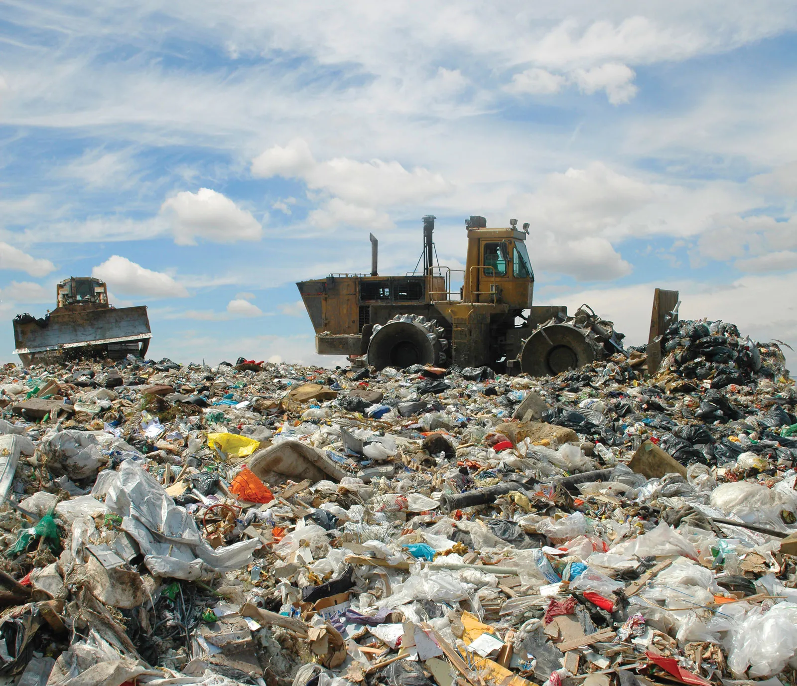
Design and Implementation of a Smart Garbage Bin for Solid Waste Management using Computer Vision and Internet of Things

Slide 2
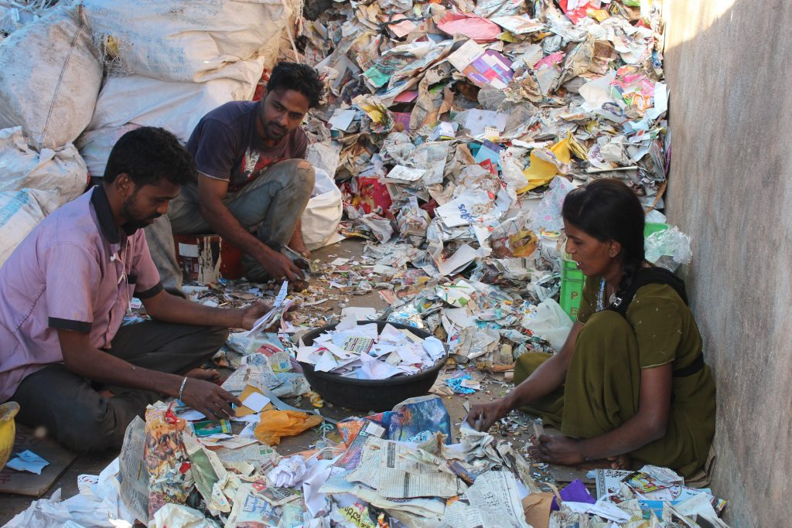
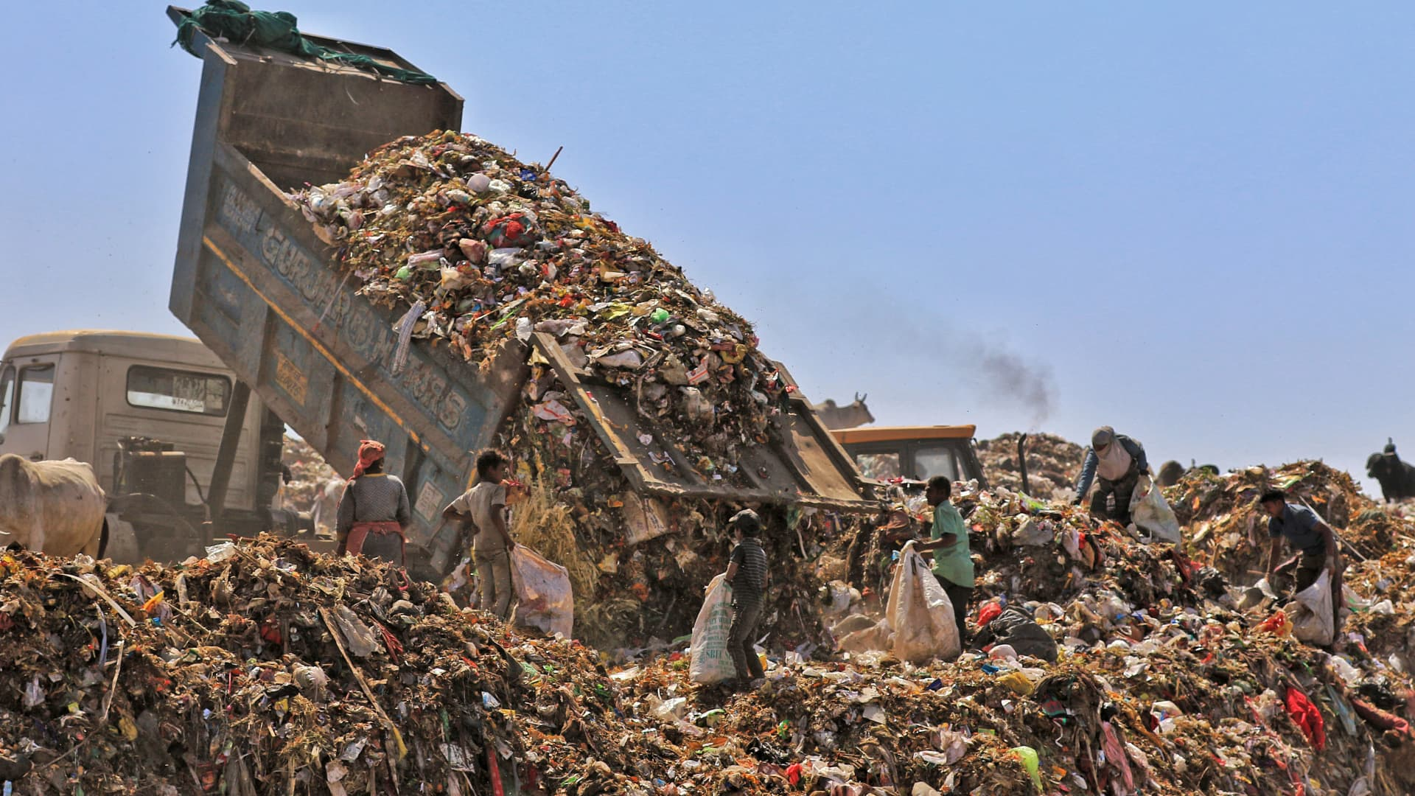
The increasing global population and urbanization have led to a significant rise in solid waste generation, posing serious environmental challenges. Proper waste management and efficient waste segregation are crucial to reducing the environmental impact and promoting sustainable living. The majority of the waste is not recycled correctly due to faulty waste segregation, and this research paper presents the design, development and implementation of a Smart Garbage Bin (SGB) equipped with computer vision and sensors for automatic solid waste segregation.

Slide 3

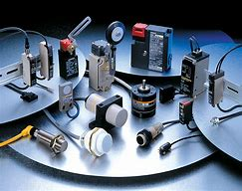
Approach:
Use of computer vision(YOLOv5 Algorithm) and sensors (Humidity Sensor and Inductive Proximity Sensor) to segregate different types of solid wastes.

Slide 4
Various Components used :
Orange Pi 5
Camera Module
Servo Motor
Inductive Proximity Sensor
Infrared Sensor
Humidity Sensor

Slide 5
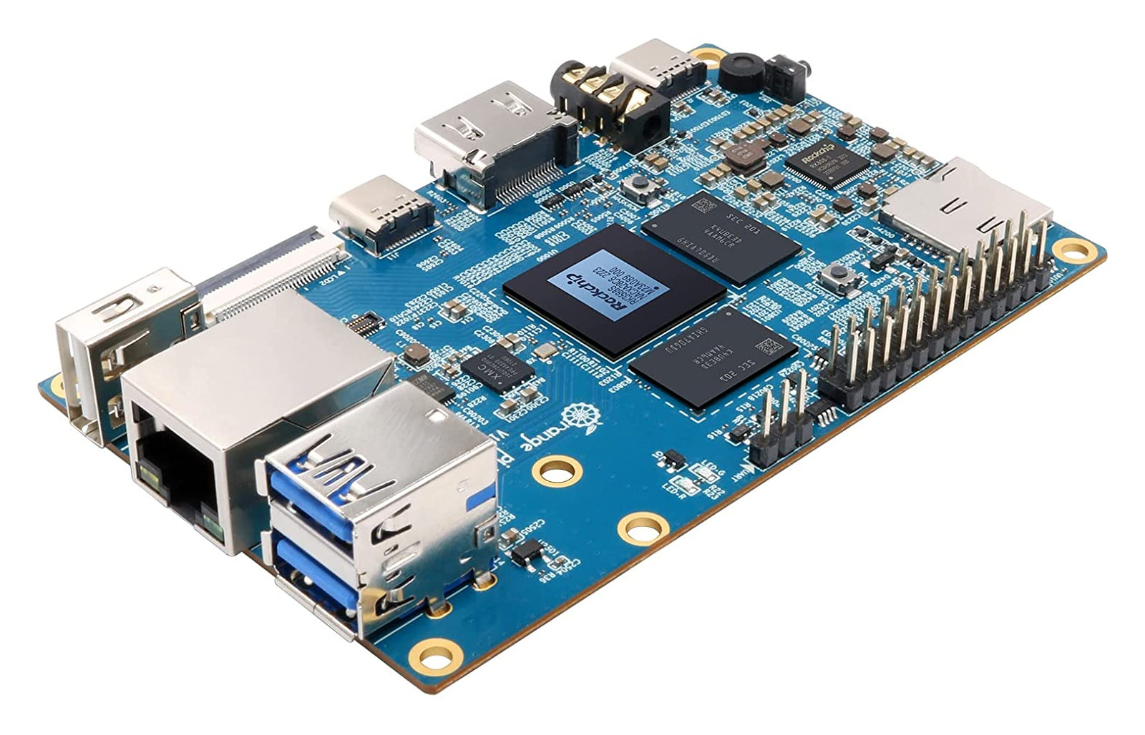
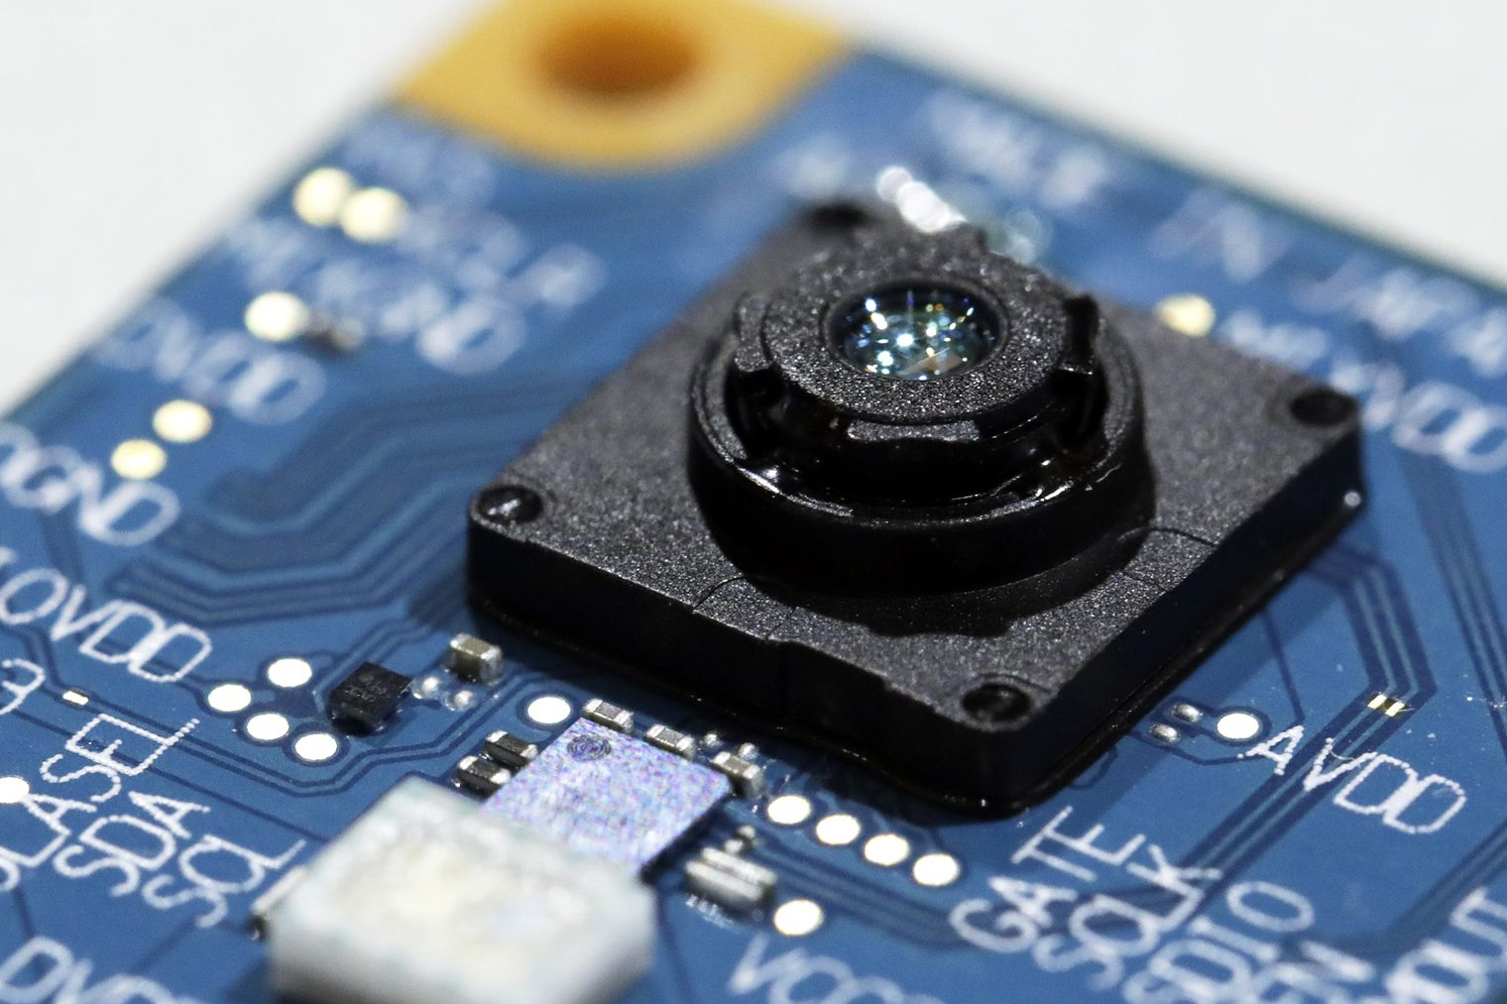


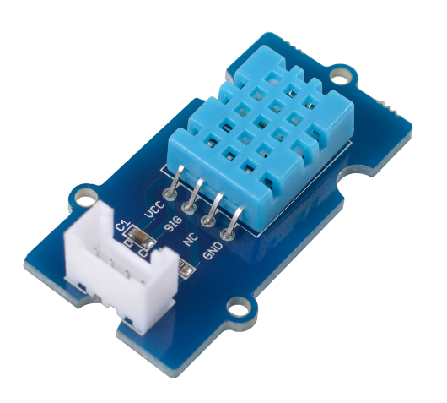
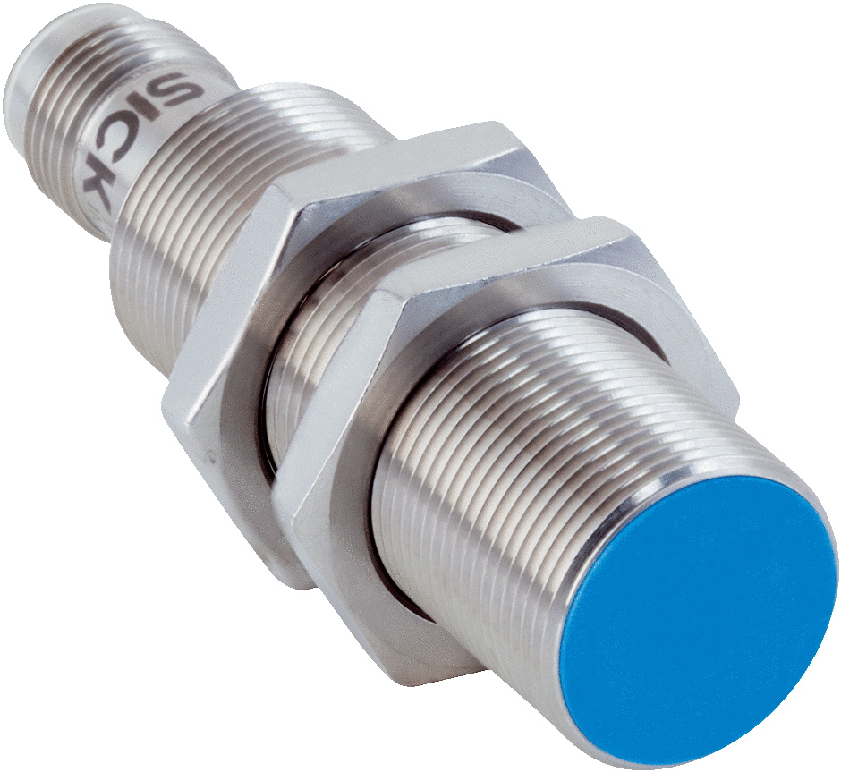
Orange Pi 5
Camera module
Servo Motors
Inductive Proximity Sensor
Infrared Sensor
Humidity Sensor

Slide 6
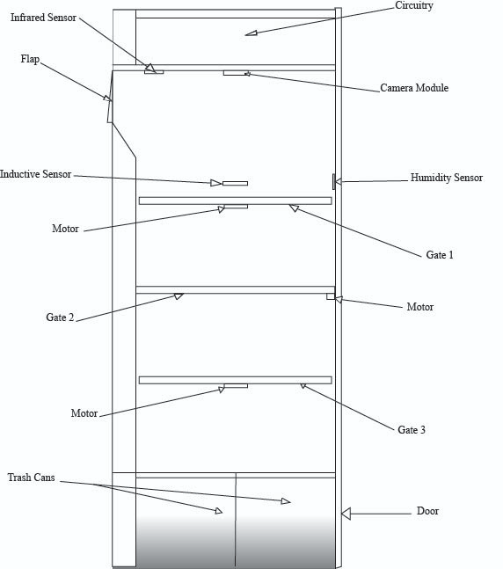
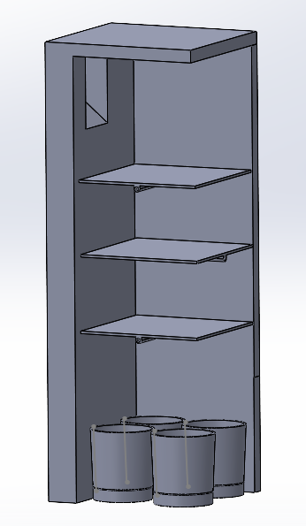
Diagram of the Garbage Bin
2D view
3D view(NTS)

Slide 7
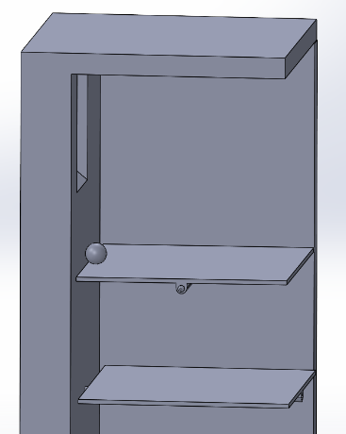
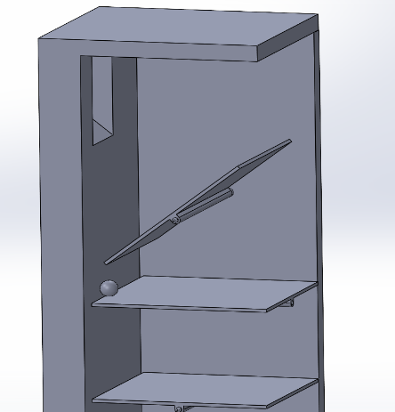
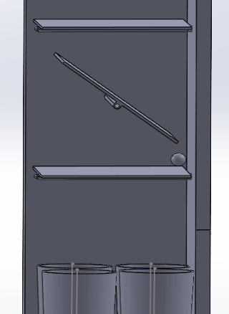
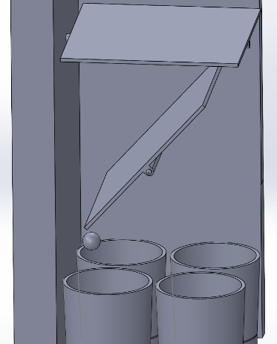
Step-by-Step Process of Waste Segregation:

Slide 8
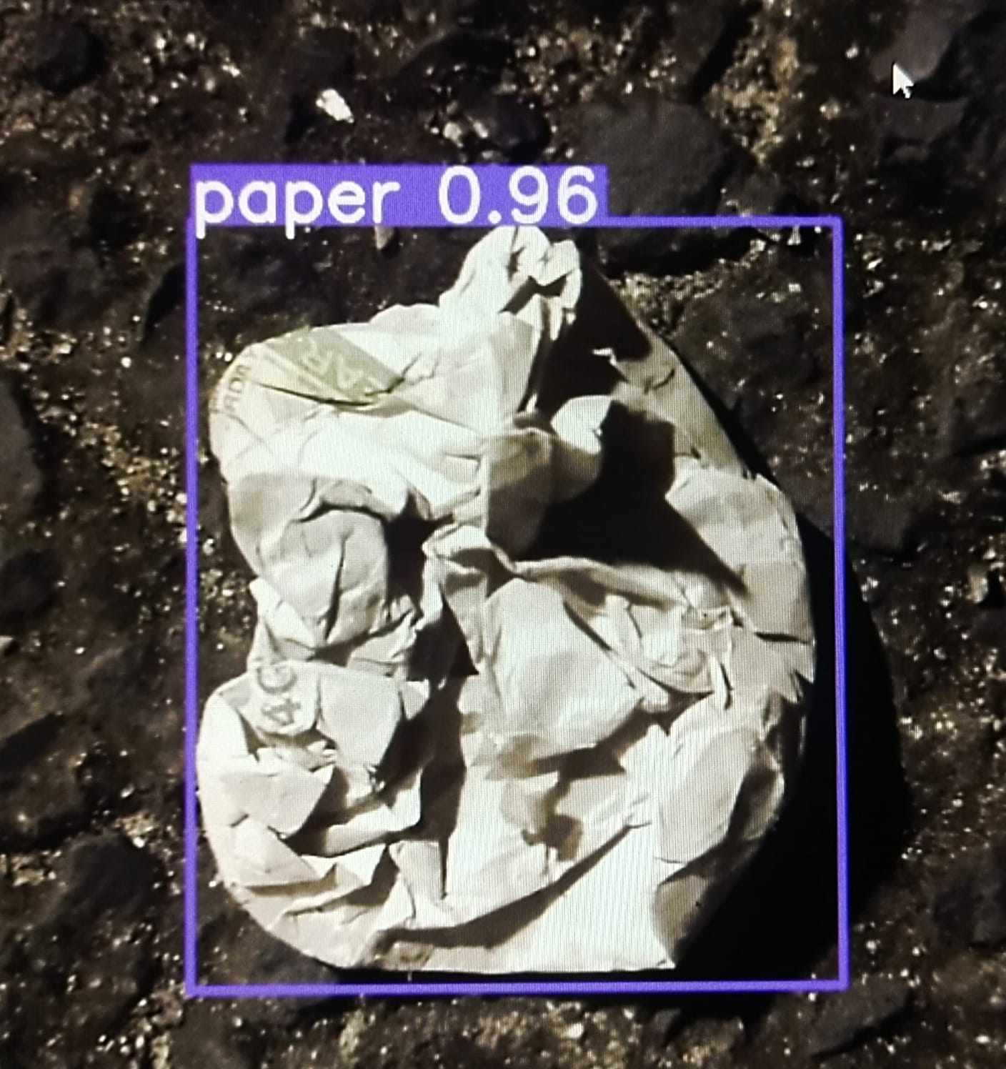
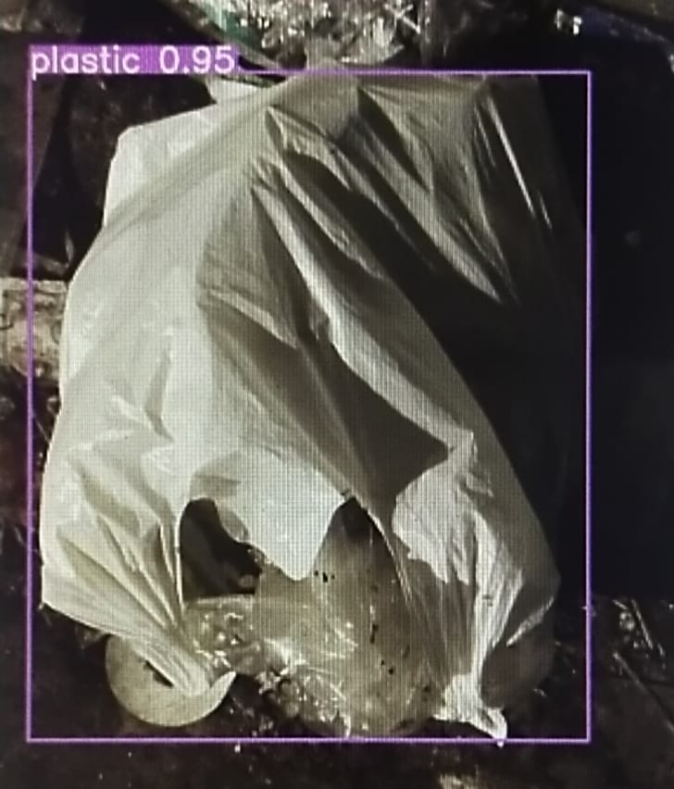
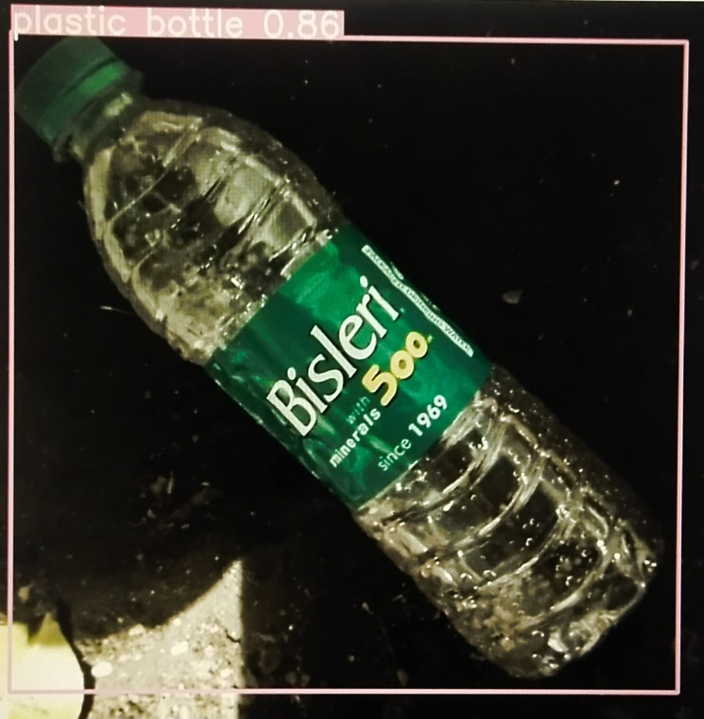
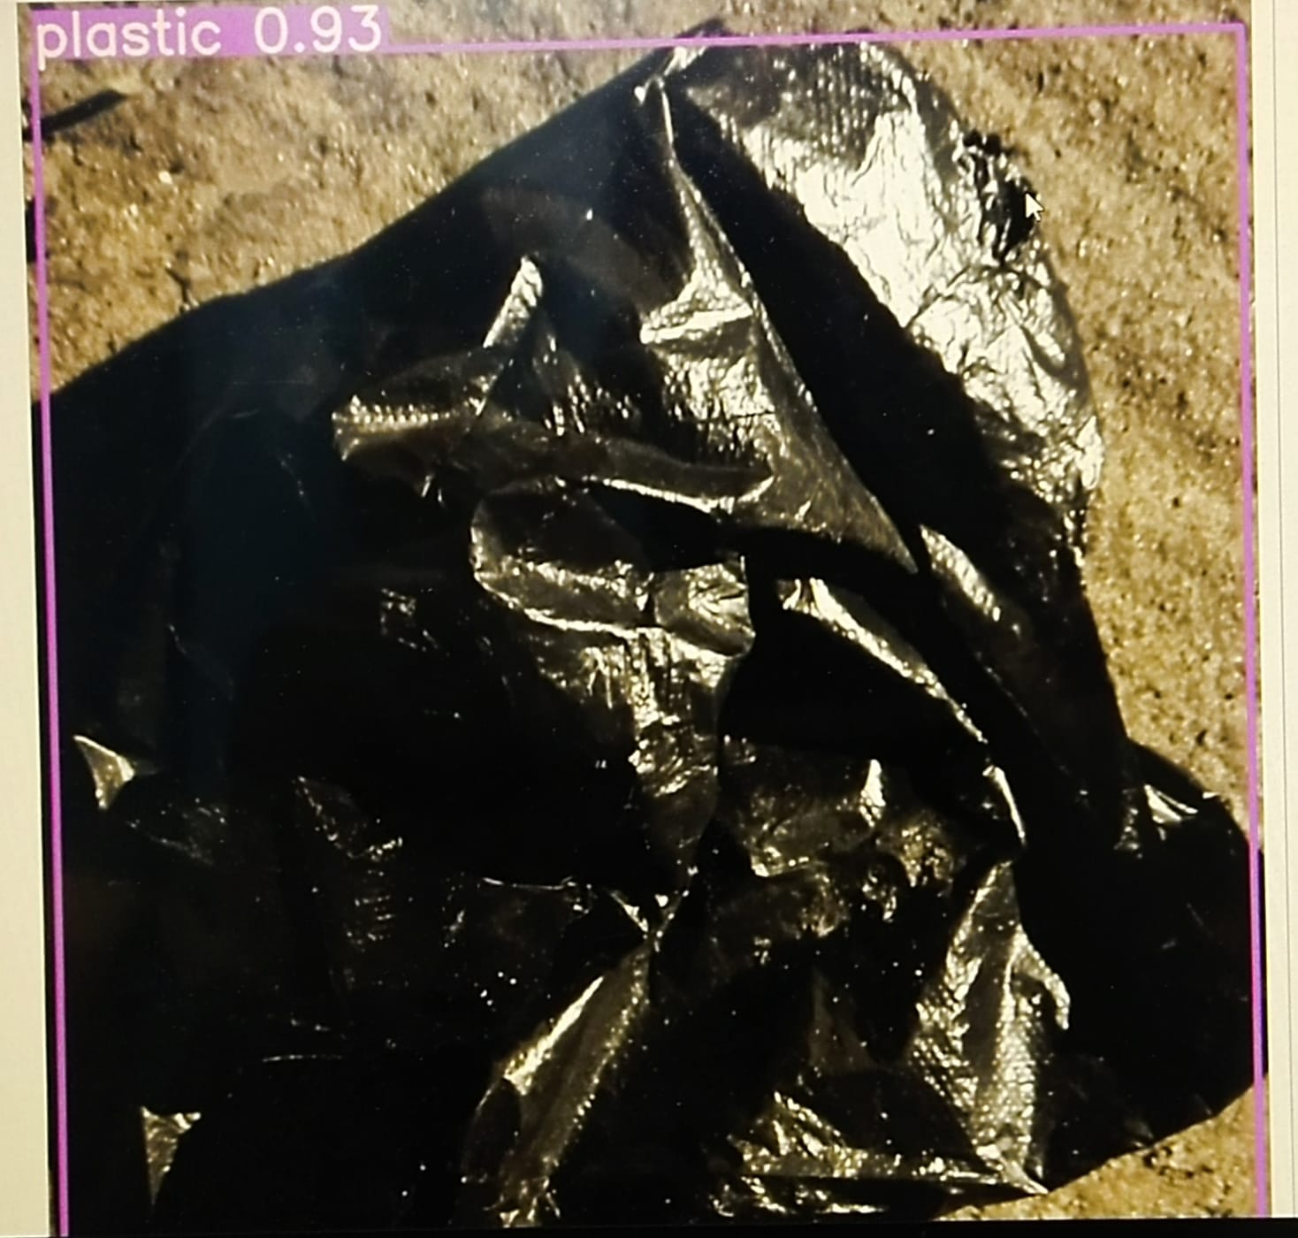
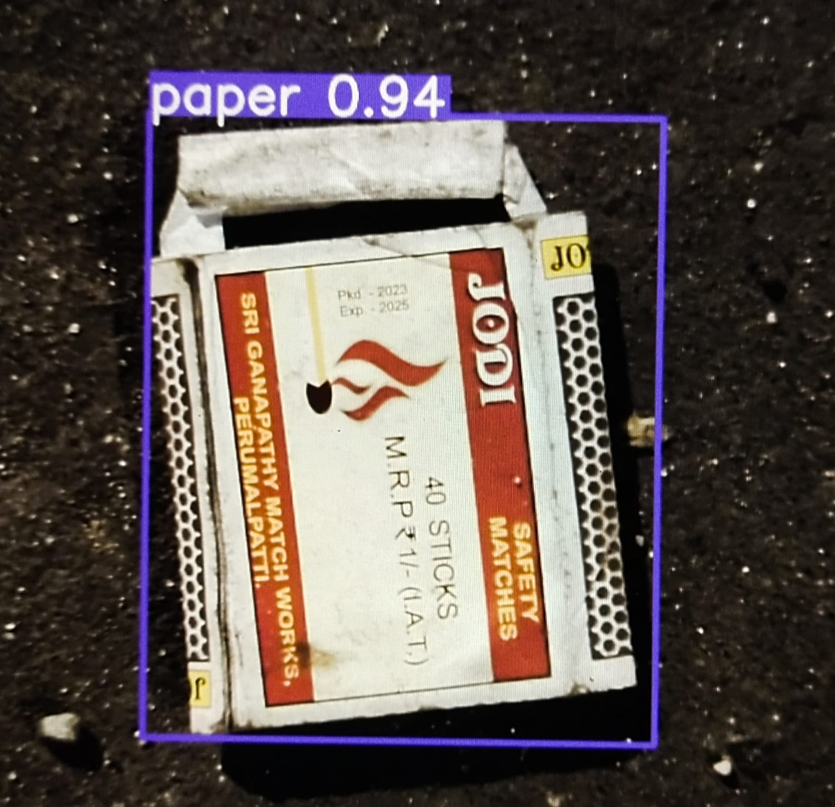
Detection of wastes using Yolov5 algorithm:

Slide 9
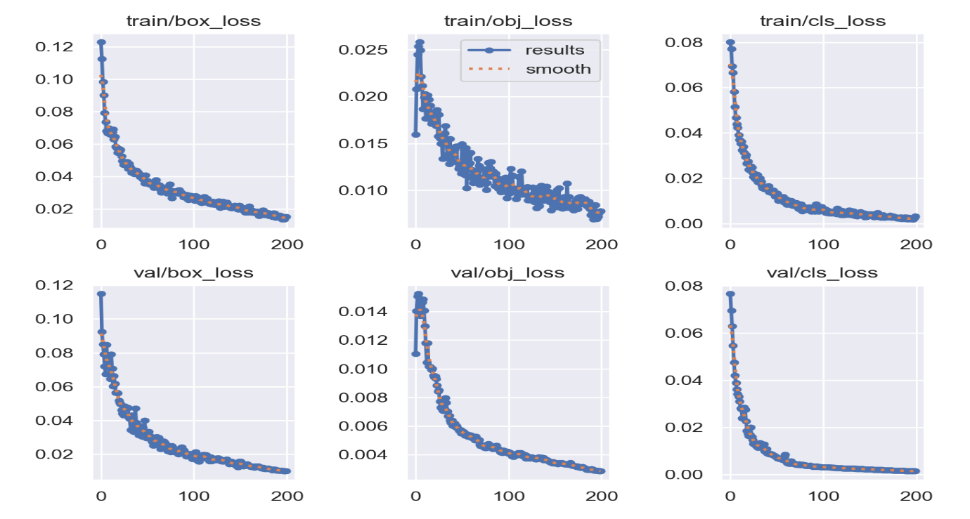
Loss Function Graph:

Slide 10
Customizability:
The use of Computer Vision (YOLOv5 Algorithm) offers a lot of customizability in the detection of the various types of wastes.
For example:- The types of waste generated in a hospital will be different as compared to the waste generated in a shopping mall. Considering this, the YOLOv5 algorithm can be trained on a distinct dataset containing images of items like syringes, bandages, and so on. This will enable the bin to segregate wastes at a higher level based on the environment it is in.

Slide 11
Conclusion
The results demonstrate the effectiveness of the Smart Garbage Bin in segregating solid waste, promoting recycling efforts, and reducing the burden on conventional waste management systems. By employing this technology, communities can significantly improve waste sorting accuracy and lower the environmental impact of mismanaged waste. The Smart Garbage Bin's ability to automatically segregate solid waste marks a significant advancement in waste management practices, fostering sustainability and paving the way for more intelligent and greener cities.

Slide 12
Acknowledgements
Special thanks to Dr. Brojendranath Dey and Dr. Srijan Paul for helping with this project.

